Slide 1
A Guide to Advanced Java
Generics and Regular Expressions
Create by BKAP
A Guide to Advanced Java
<number>/28

Slide 2
Review
java.util Packages mainly contains collection classes that are useful for working with groups of objects. Type of Lists: ArrayList, Vector, LinkedList.
Sets creates a list of unordered objects or non-duplicate list of object references. It inherits all the methods from the Collection interface except those methods that allow duplicate elements.
Type of sets: sortedset, hashset, linkedhashset and treeset

Slide 3
Review…
Maps object stores data in the form of relationships between keys and values.
Two general-purpose Map implementation:
  HashMap.
  TreeMap.
Important methods of Map: put(K key, V value); get(Object key); containsKey(Object Key); containtsValue(Object value); size() and values().
Classes of Map: HashMap, HashTable, TreeMap, LinkedHashMap.
Queue and Array class

Slide 4
Objectives 1
Introduction to Generics
Generic Classes
Generic Methods
Using wildcards with generics
Create by BKAP
A Guide to Advanced Java
<number>/28

Slide 5
Introduction to Generics
Genericity is a way by which programmers can specify the type of objects that a class can work with via parameters passed at declaration time and evaluated at compile time. Generic types can be compared with functions which are parameterized by type variables and can be instantiated with different type arguments depending on the context.
Create by BKAP
A Guide to Advanced Java
<number>/28

Slide 6
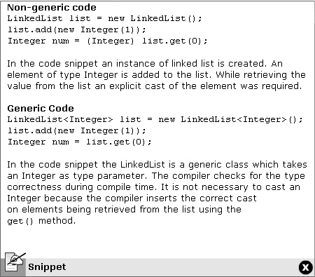
Demo
Create by BKAP
A Guide to Advanced Java
<number>/28

Slide 7
Advantages and Limitations of Generics
Advantages of generics
  Generics allow flexibility of dynamic binding
  Generic type helps the compiler to check for type correctness of the program at the compile time.
  In generics the compiler detected errors are less time consuming to fix that runtime errors.
Limitations of generics
  In generics you cannot create generic constructors
  A local variable cannot be declared where the key and value types are different from each other.30
Create by BKAP
A Guide to Advanced Java
<number>/28

Slide 8
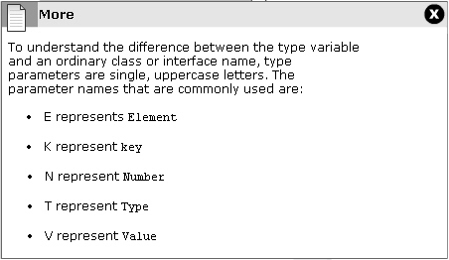
Generic Classes
A generic class is a mechanism to specify the type relationship between a component type and its object type.
Create by BKAP
A Guide to Advanced Java
<number>/28

Slide 9
Creating Generic Classes
public class NumberList <T>{
private T obj;
public void add(T val){
…
}
public static void main(String[] args){
NumberList<String> listObj=new NumberList<String>
}
Create by BKAP
A Guide to Advanced Java
<number>/28

Slide 10
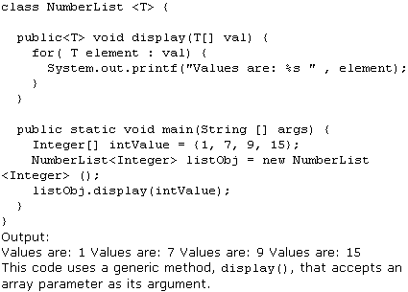
Generics Methods
Generic method can be defined as a method with type parameters. Generic methods are best suited for overloaded methods that perform identical operations for different argument type.
Create by BKAP
A Guide to Advanced Java
<number>/28

Slide 11
Using Wildcards with Generics
There are three types of wildcards used with generics.
  “?” : represents an unknown type in generics. It denotes the set of all types or any one type. So List<?> means that the list contains unknown object type.
  “? extends Type”: represents an unknown type that is a subtype of the bounding class. The word ‘Type’ specifies an upper bound, which states that the value of the type parameter must either extend the class or implement the interface of bounding class.
  “? super Type”: represents an unknown type that is a supertype of the bounding class. The word ‘Type’ specifies a lower bound.
Create by BKAP
A Guide to Advanced Java
<number>/28

Slide 12
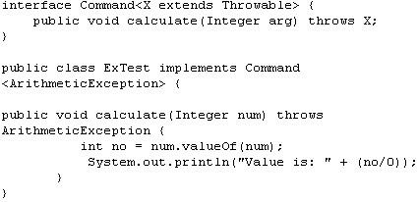
Exception Handling with Generics
Exceptions provide a reliable mechanism for identifying and responding to error conditions. The catch clause present with a try statement checks that the thrown exception matches the given type.
Create by BKAP
A Guide to Advanced Java
<number>/28

Slide 13
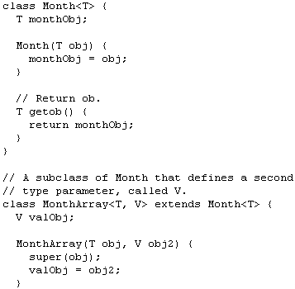
Inheritance with Generics
Classes can extend generic classes, and provide values for type parameters or add new type parameters. A class cannot inherit from parametic type. Two instantiations of the sam generic type cannot be used in inheritance
Create by BKAP
A Guide to Advanced Java
<number>/28

Slide 14
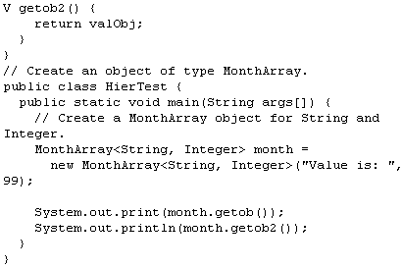
Inheritance with Generics
Classes can extend generic classes, and provide values for type parameters or add new type parameters. A class cannot inherit from parametic type. Two instantiations of the sam generic type cannot be used in inheritance
Create by BKAP
A Guide to Advanced Java
<number>/28

Slide 15
Summary 1
Generics Genericity is a way by which programmers can specify the type of objects that a class can work with via parameters passed at declaration time and evaluated at compile time
Generic Classes is a mechanism to specify the type relationship between a component type and its object type.
Generic Methods can be defined as a method with type parameters.
There are three types of wildcards used with generics

Slide 16
Objectives 2
Introduction to Regular Expression
String Literals
Character Classes
Quantifiers
Boundary Matchers
Create by BKAP
A Guide to Advanced Java
<number>/28

Slide 17
Introduction to Regular Expression
Regular expressions help describing a pattern of text. A regular expression (regex) is a string consisting of characteristics that matches a string in the set of strings. In other words, ‘regex’ is a set of symbols and syntactic elements which are used to match patterns in a text. They are used to search, edit and manipulate text based on patterns. The regex package, java.util.regex consists of classes which allow pattern matching.
Create by BKAP
A Guide to Advanced Java
<number>/28

Slide 18
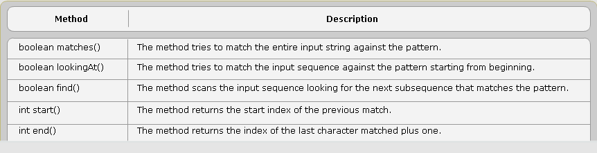
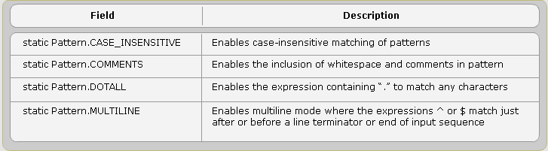
Regular Expression API
The three main classes present in the regular expression API are
Matcher
Pattern
PatternSyntaxException
Create by BKAP
A Guide to Advanced Java
<number>/28

Slide 19
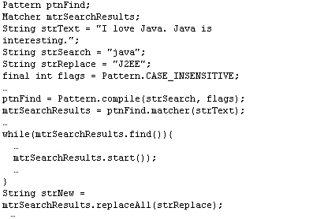
Example
Create by BKAP
A Guide to Advanced Java
<number>/28

Slide 20
String Literal
The basic form of pattern matching supported by regex is String Literal. A literal is constant value used to initialize variables. Literals can be:
  boolean(TRUE or FALSE)
  numberic(integer, floating point, or fixed point)
  character-based( a single character or a string)
Create by BKAP
A Guide to Advanced Java
<number>/28

Slide 21
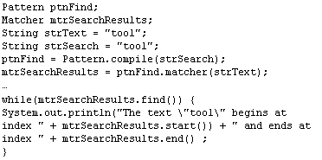
Example
Create by BKAP
A Guide to Advanced Java
<number>/28

Slide 22
Metacharacters
Metacharacters are the special characters which affect the way a pattern is matched. Special characters which behave as metacharacter and supported by the API are ([{\^-$|])?*+.
Create by BKAP
A Guide to Advanced Java
<number>/28

Slide 23
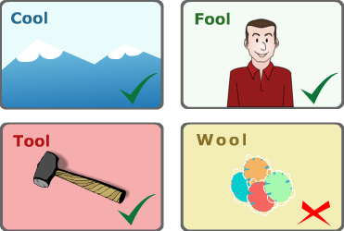
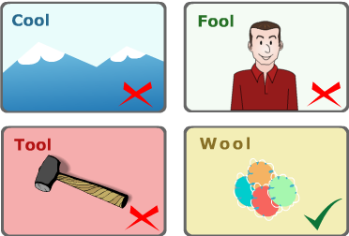
Charater Classes>>Simple classes
Simple classes are the most basic form of a character class. This formed by placing a set of charaters side-by-side within square brackets.
Consider a regular expression [ftc]ool -> H1. else Negation expression [ftc]ool –> H2
H1
H2
Create by BKAP
A Guide to Advanced Java
<number>/28

Slide 24
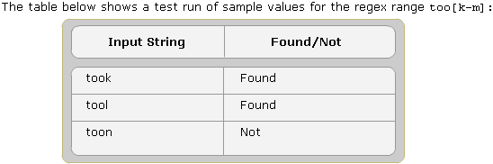
Ranges
A Character class can be defined that includes a range of value such as the letters “a through z” the numbers “0 throught 9”. The metatcharacter, “-”, is inserted between the first and last character to specify a range of value to be matched such as [a-z] and [0-9].
Create by BKAP
A Guide to Advanced Java
<number>/28

Slide 25
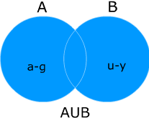
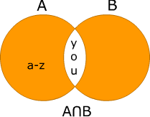
Unions and Intersections
Unions create a single character class comprising of two or more separate character classes.
[a-g[u-y]]
[a-z&&[you]]
Create by BKAP
A Guide to Advanced Java
<number>/28

Slide 26
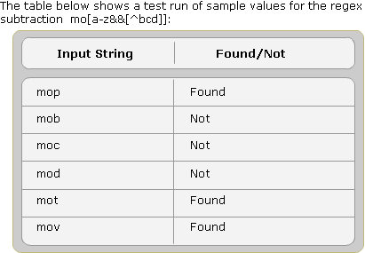
Subtraction
Subtraction is used to negate one or more nested character classes
Create by BKAP
A Guide to Advanced Java
<number>/28

Slide 27
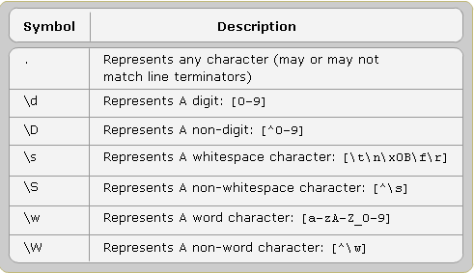
Predefined Character Classes
Many useful predefined character classes are contained in the pattern API, which can replace the frequently used regular expressions.
Create by BKAP
A Guide to Advanced Java
<number>/28

Slide 28
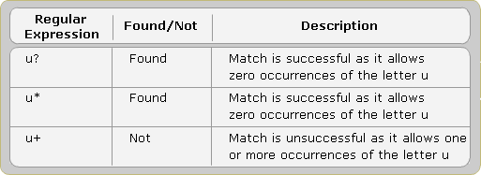
Repeated
Quantifiers allow the user to specify the number of occurrences for a match to match against. There are three types of quantifiers: greedy, reluctant and possessive quantifiers
Create by BKAP
A Guide to Advanced Java
<number>/28

Slide 29
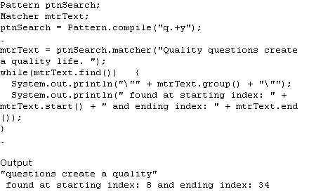
Example
Create by BKAP
A Guide to Advanced Java
<number>/28

Slide 30
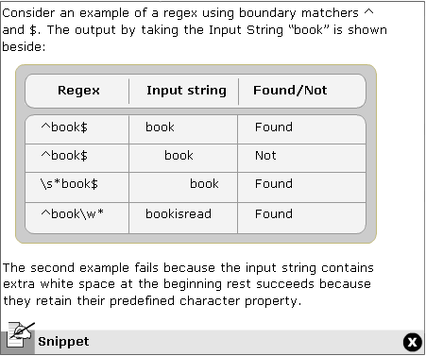
Boundary Matchers
Boundary matchers are used for a more specific and precise pattern matching by knowing the exact location of the matching string in a particular input string.
Create by BKAP
A Guide to Advanced Java
<number>/28

Slide 31
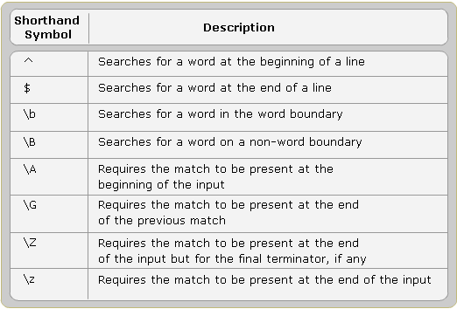
List Boundary Matchers
Create by BKAP
A Guide to Advanced Java
<number>/28

Slide 32
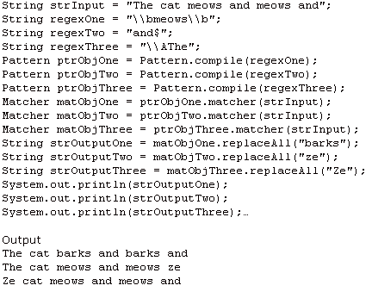
Example
Create by BKAP
A Guide to Advanced Java
<number>/28

Slide 33
Summary 2
Introduction to Regular Expression is a string consisting of characteristics that matches a string in the set of strings.
String Literals are constant value used to initialize variables.
Character Classes can be defined that includes a range of value such as the letters “a through z” the numbers “0 throught 9”.
Boundary Matchers are used for a more specific and precise pattern matching by knowing the exact location of the matching string in a particular input string.

Slide 34

Summary and Workshop
Create by BKAP
A Guide to Advanced Java
<number>/28

